Slide 1
IMPORT YOUR 3D MODELS
Learn how to leverage your 3D expertise in Office Applications

Slide 2
WHY PRESENT 3D IN POWERPOINT?
3D helps foster conceptual understanding and visual and spatial thinking.
If your company already has a rich library of 3D assets built in other applications that just a handful of employees are using, those assets are being wasted.
By bringing those assets into PowerPoint, you are making those assets more portable, flexible, and easier for anyone in the company to use, share, and leverage.

Slide 3
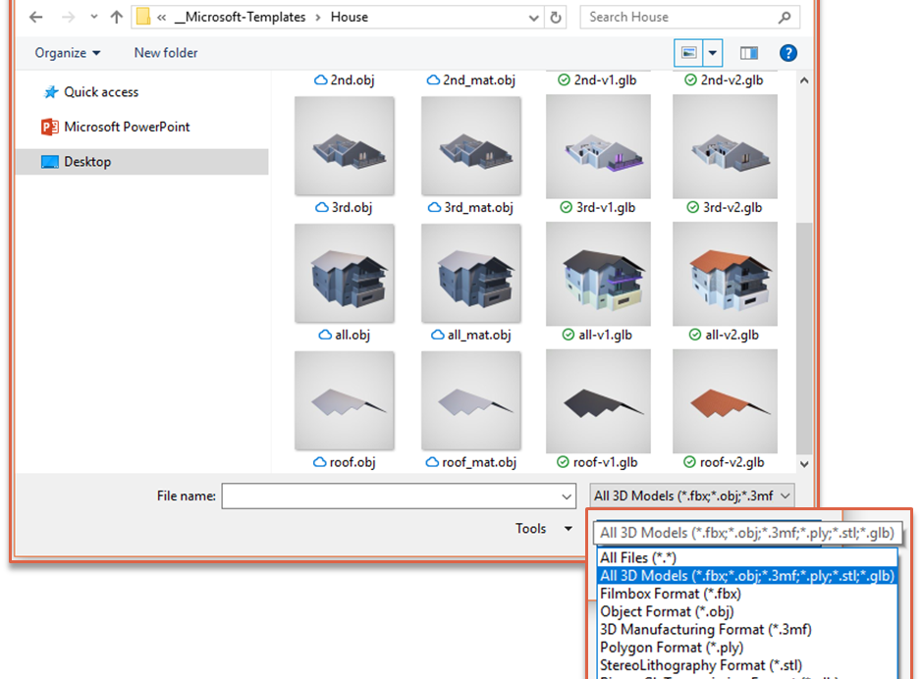
IMPORT YOUR MODEL AS ONE OF THE RECOMMENDED 3D FORMATS
There are many files types that can be imported into PowerPoint from other 3D applications:
FBX
OBJ
3MF
PLY
STL
GLB

Slide 4
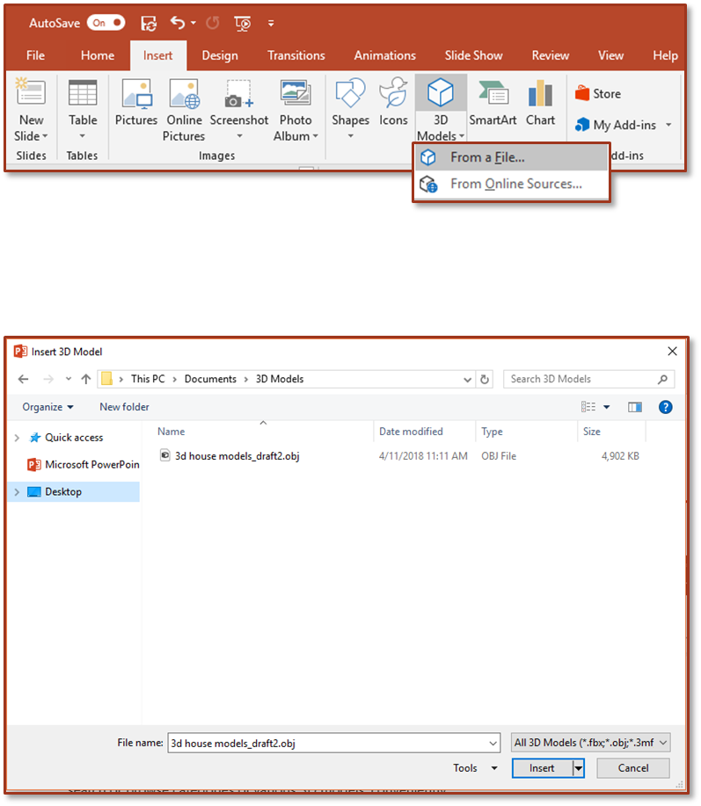
HOW TO INSERT A 3D MODEL FROM A FILE
1
Go to Insert
3D Models 
From a File…
That will open the Insert 3D Model window where you can search your computer, network, or cloud drive for any saved 3D models.
Insert the 3D model:
Select the file and Click on Insert.
The 3D Model will now be placed onto your PowerPoint slide.
2

Slide 5
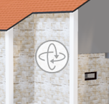
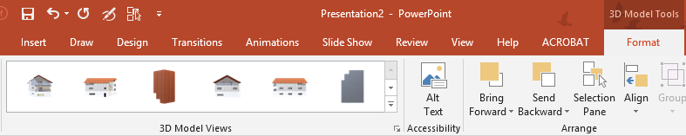
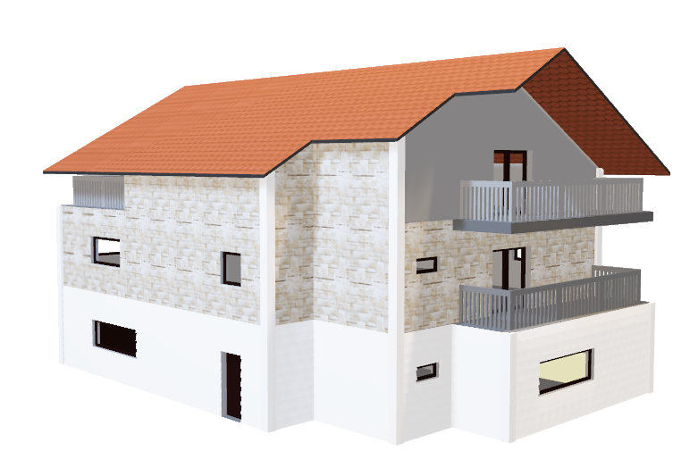
TWO FAST WAYS TO POSITION AND ROTATE YOUR 3D MODEL
1
Click or tap to select your 3D Model
> Click and hold on the 3D control to rotate or tilt your 3D model up, down, left, and right.
TRY IT YOURSELF WITH THIS HOUSE
3D Control
2
Alternatively, with your model selected, on the Ribbon, in the 3D Model Tool Format tab, you can click on 3D Model Views gallery to apply one of the various position views.

Slide 6
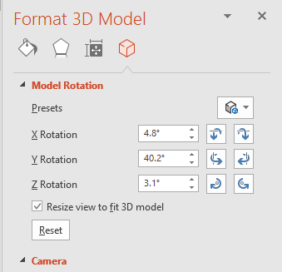
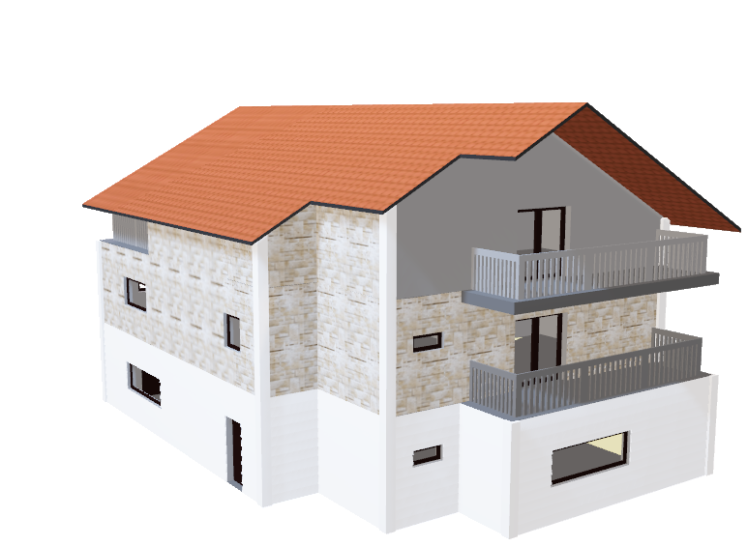
FOR MORE PRECISE MODEL POSITIONING…
Click on the Format 3D Model button located in the lower right-hand corner of the 3D Model Views group.
That will open the Format 3D Model Task Pane to the right of the PowerPoint window where you can more precisely adjust the X, Y, and Z Rotation of your 3D Model.
TRY IT YOURSELF WITH THIS HOUSE ABOVE

Slide 7
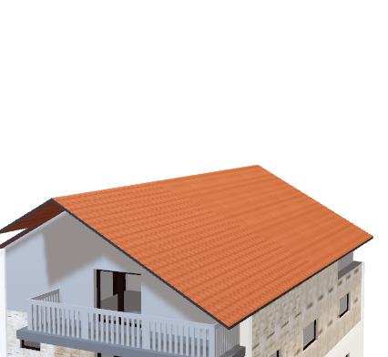
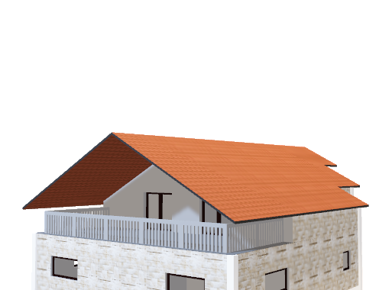
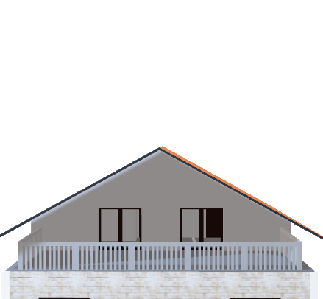
PAN AND ZOOM
How it works:
To “crop” your 3D model within a frame, you can use the pan and zoom tool.
Select your 3D model > 3D Models Format > Pan & Zoom.
With the Pan & Zoom button enabled, now move, rotate, and resize your 3D model.
When you are finished editing, click the Pan & Zoom button again to exit Pan and Zoom mode.
TRY IT YOURSELF WITH ANY OF THESE MODELS

Slide 8
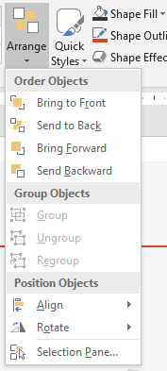



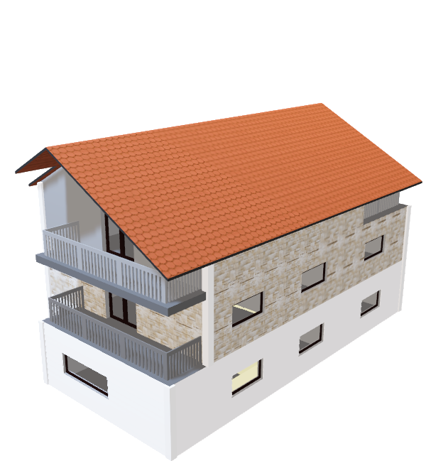
PLACING AND ARRANGING ADDITIONAL OBJECTS
1
Select the House, go to Home
> Arrange
> Send to Back. The house should now appear to be behind the left tree and the shrub.
2
Select the right tree, go to Home
> Arrange
> Send to Back. The tree should now appear to be behind and to the side of the house.
TRY IT YOURSELF WITH THIS HOUSE

Slide 9
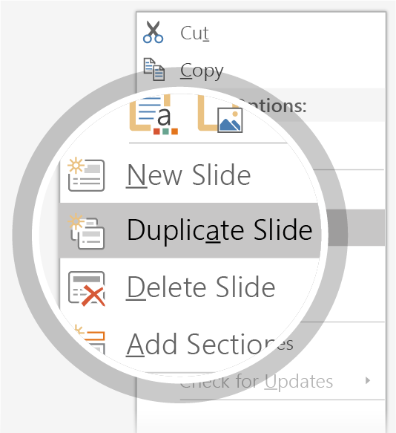
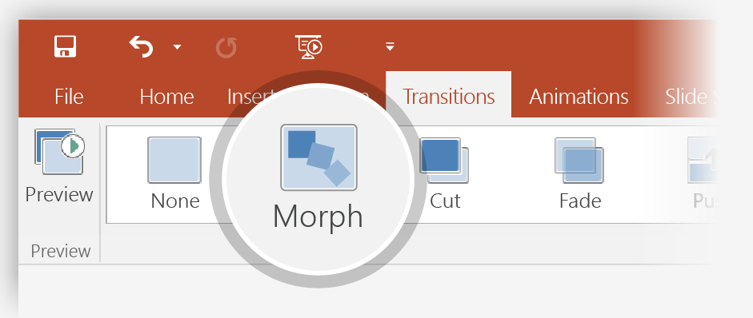
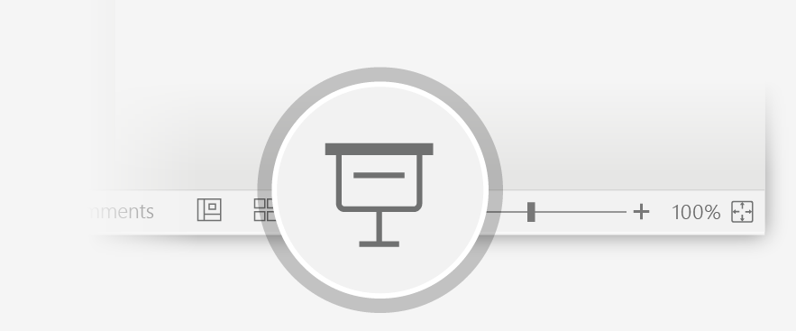
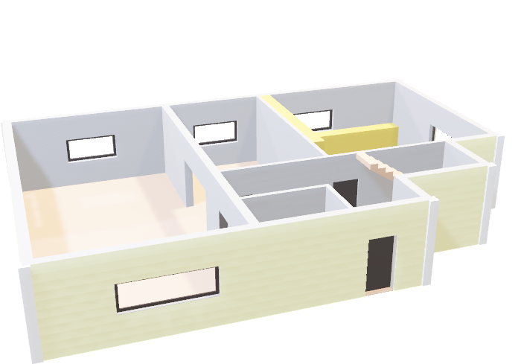
ANIMATE YOUR 3D MODEL USING THE MORPH TRANSITION
1
Duplicate this slide:
Right-click the slide thumbnail and select Duplicate Slide.
TRY IT YOURSELF WITH THIS MODEL BELOW
2
In the second of these two identical slides, change the 3D Model on the right in some way (rotate, move, or resize), then go to Transitions > Morph.
3
Return to the first of the two slides and press the Slide Show button and then select Play to see your house morph!

Slide 10


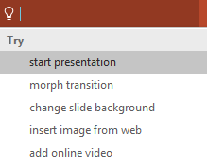

MORE QUESTIONS ABOUT PowerPoint ?
Select the Tell Me button and type what you want to know.
VISIT THE POWERPOINT TEAM BLOG
GO TO FREE POWERPOINT TRAINING
CLICK THE ARROW WHEN IN SLIDE SHOW MODE

